Slide 1
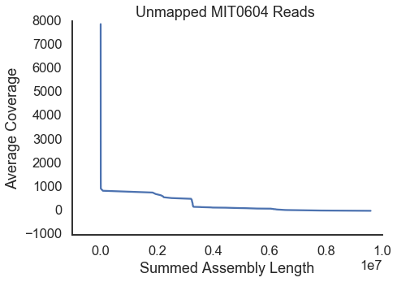
Unmapped MIT0604 top cover contigs
Node | Length | Coverage | Subject | Accession | Qcov | Ident
2792 | 128 | 7,881.00
2781 | 405 | 209.22 | transposase [Palleronia rufa] | WP_161785528 | 0.25 | 0.21
483 | 1652 | 71.38 | IS1380 family transposase [Marinobacter sp. B9-2] | PTB93145 | 0.28 | 0.28
2783 | 349 | 66.89
2793 | 128 | 64.00
647 | 1283 | 54.33 | CBS domain-containing protein [Cyanothece sp. SIO1E1] | NET30525 | 0.04 | 0.03
2790 | 200 | 53.53
2006 | 538 | 51.73 | hypothetical protein A9Q78_09185, partial [Methylophaga sp. 41_12_T18] | OUR71561 | 0.18 | 0.14
https://blast.ncbi.nlm.nih.gov/Blast.cgi?CMD=Get&RID=JKMVRDZ0014

Slide 2
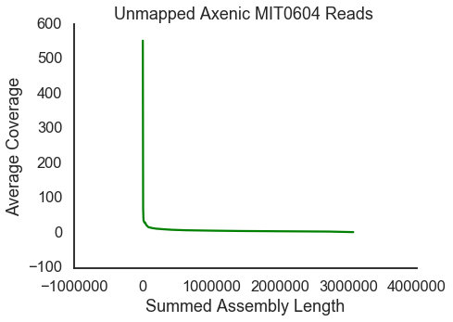
Unmapped Axenic MIT0604 top cover contigs
Node | Length | Coverage | Subject | Accession | Qcov | Ident
1224 | 128 | 553.00
490 | 1652 | 28.50 | IS1380 family transposase [Marinobacter sp. B9-2] | PTB93145 | 0.28 | 0.28
1222 | 140 | 24.62 | hypothetical protein A9Q78_09185, partial [Methylophaga sp. 41_12_T18] | OUR71561 | 0.32 | 0.28
1220 | 200 | 24.38
1203 | 283 | 20.56 | hypothetical protein, partial [Mesorhizobium sp. YM1C-6-2] >gb|RLP24073.1| hypothetical protein ... | WP_121582627 | 0.18 | 0.11
https://blast.ncbi.nlm.nih.gov/Blast.cgi?CMD=Get&RID=JKMWMHBA014

Slide 3
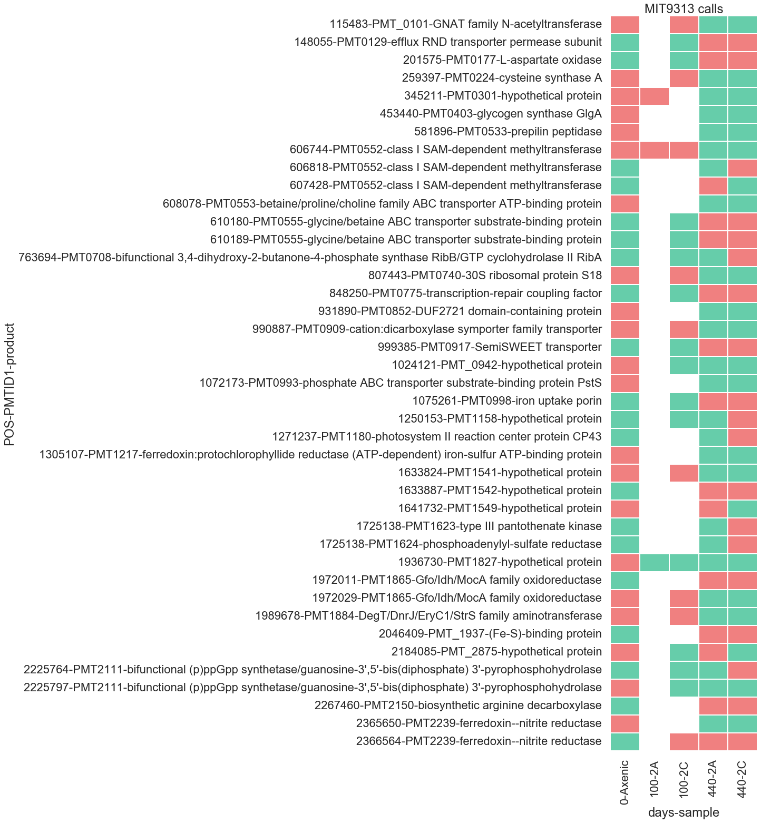
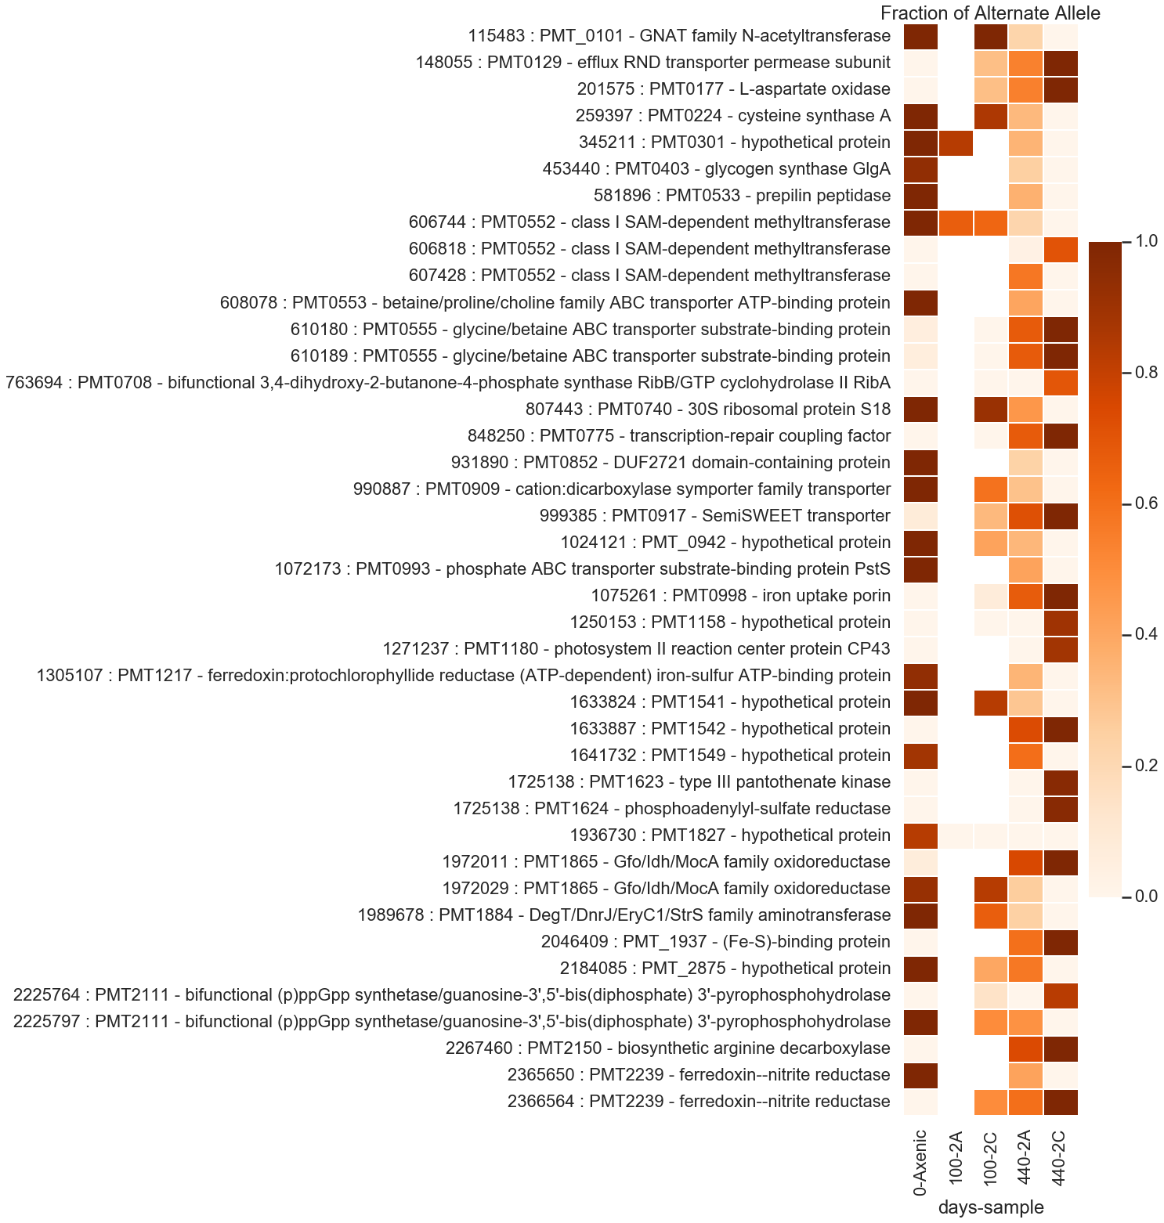
Mit9313 snps 8/5 After removing low quality bases

Slide 4
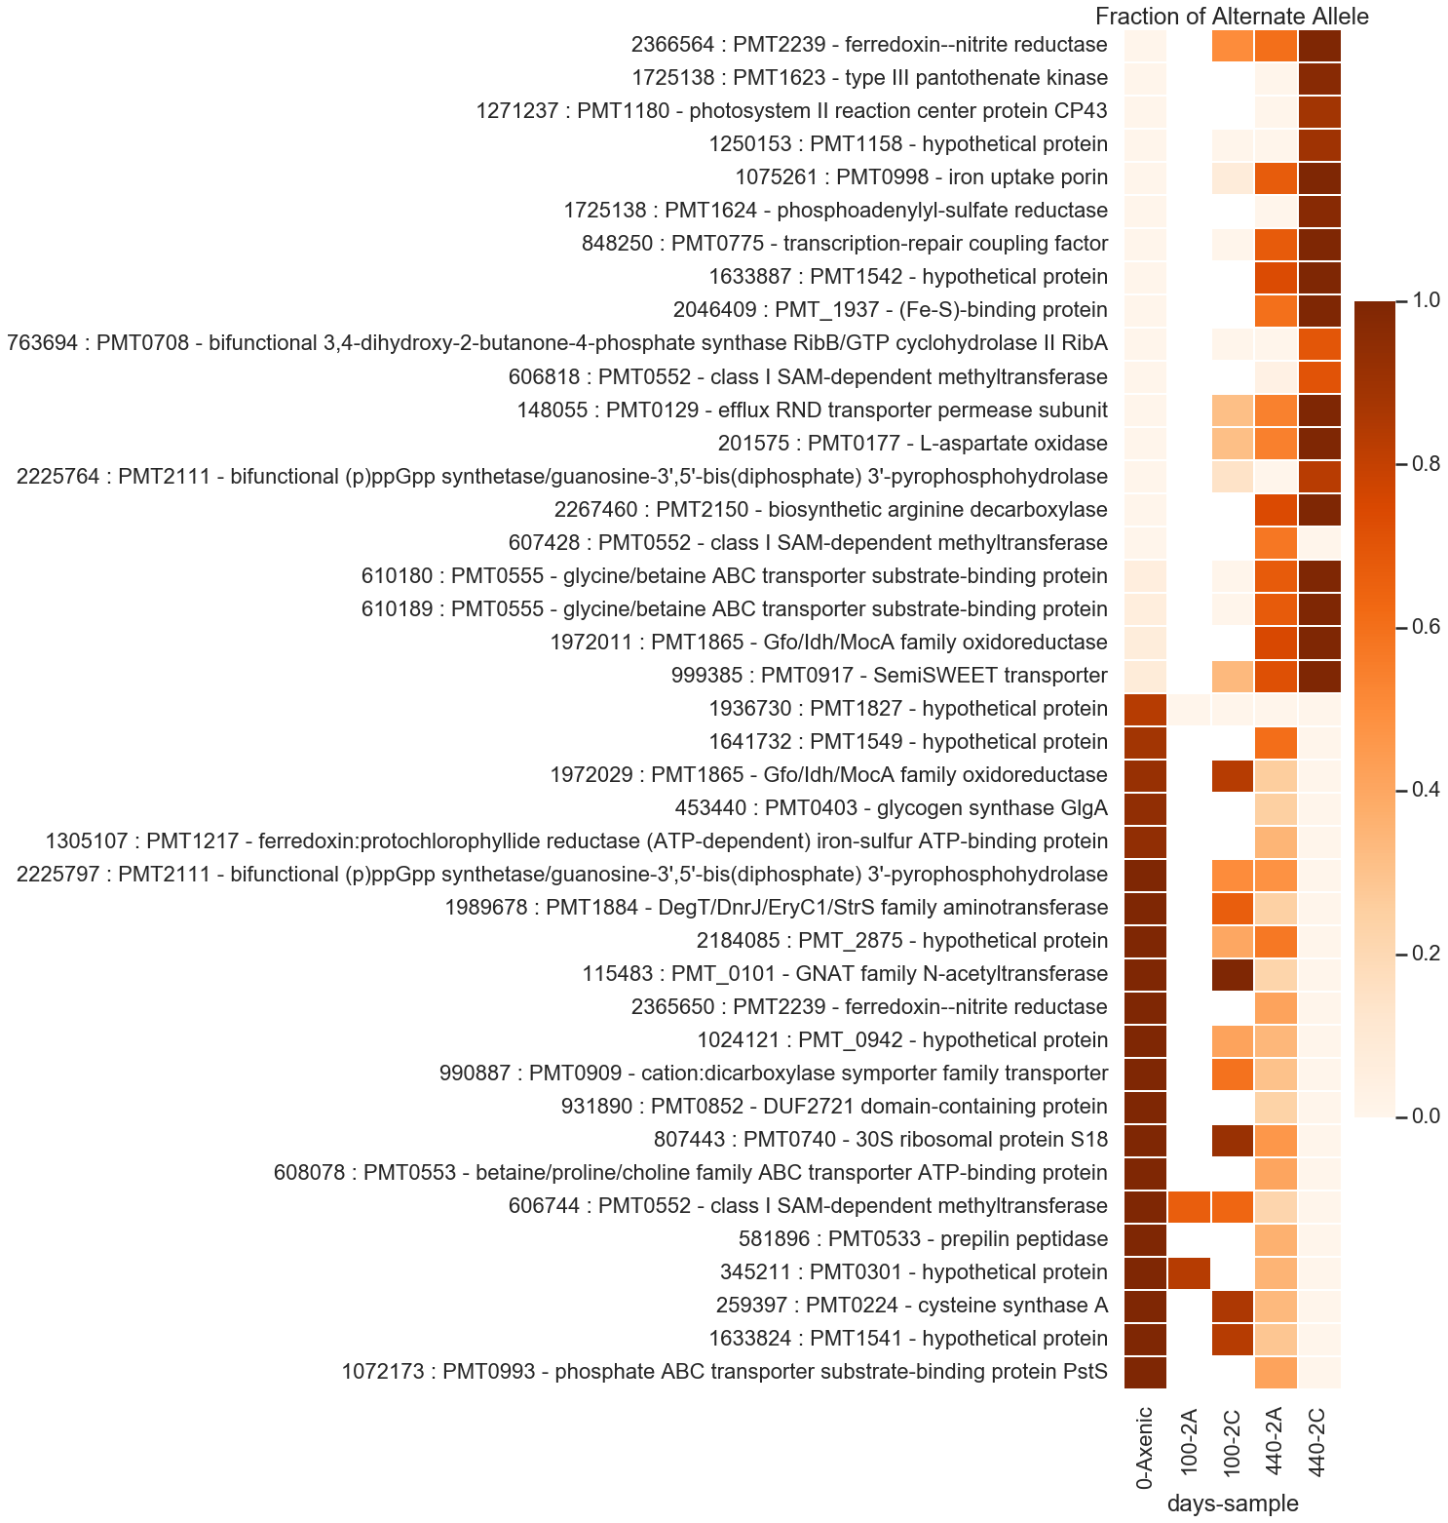

Slide 5
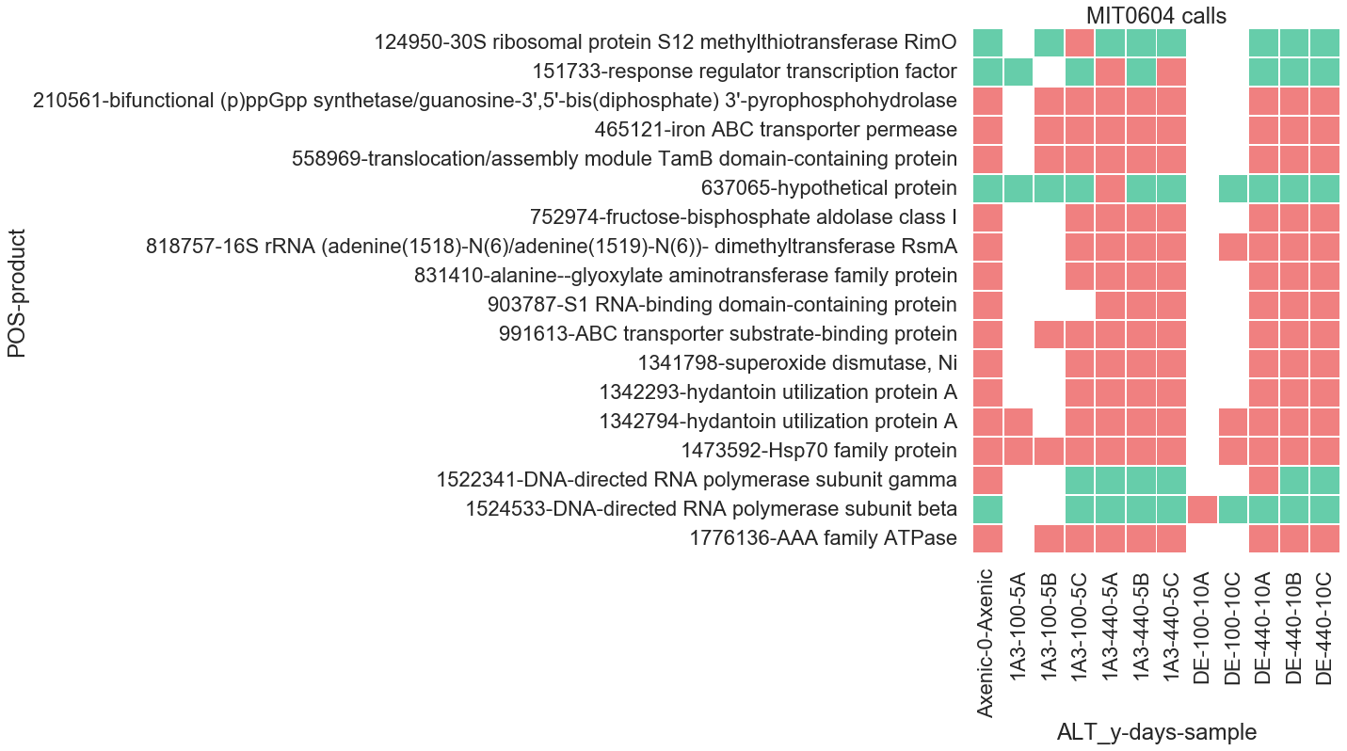
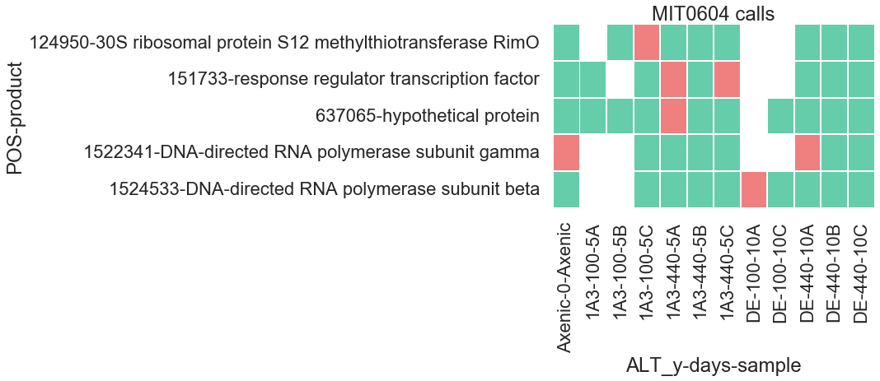
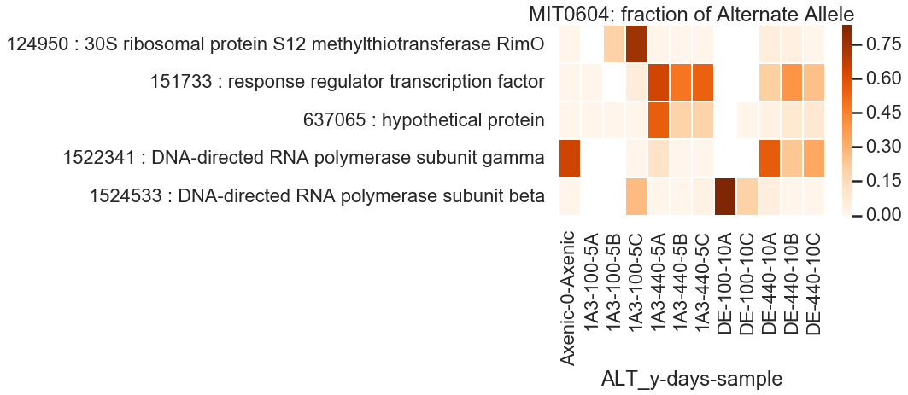
Mit0604 snps 8/5 After removing low quality bases

Slide 8
Filtering SNPs
Per SNP:
At least one sample has
alternate genotype
depth > 10
(AO)/(DP) > 0
SNP quality > 100
Alternate observations on both strands
At least 2 reads placed on each side (left and right)
Per sample:
Depth > 10
GQ > 20
Genotype Quality, the Phred-scaled marginal (or unconditional) probability of the called genotype – 99% probability

Slide 9
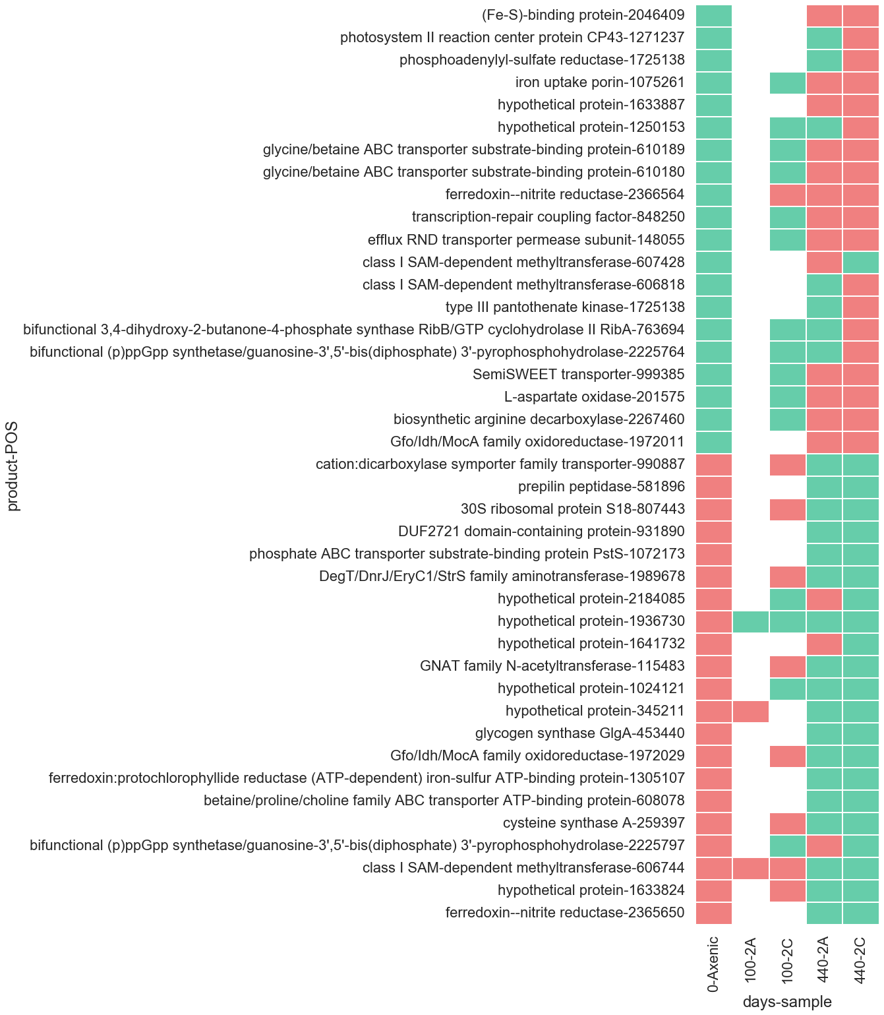
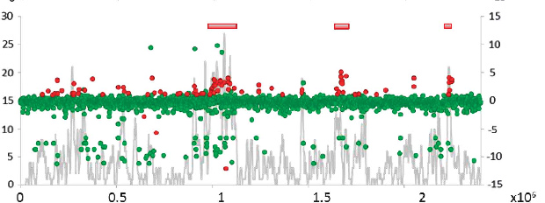
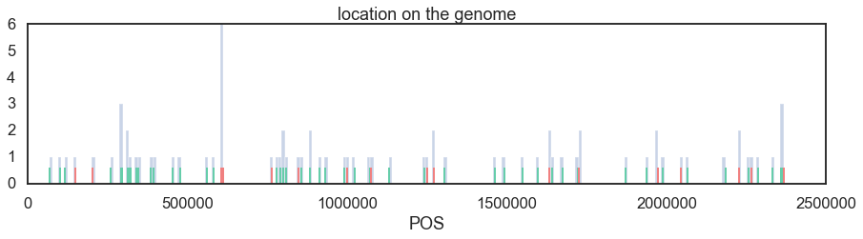
MIT9313 calls
77 calls on CDS
left after filtering

Slide 10
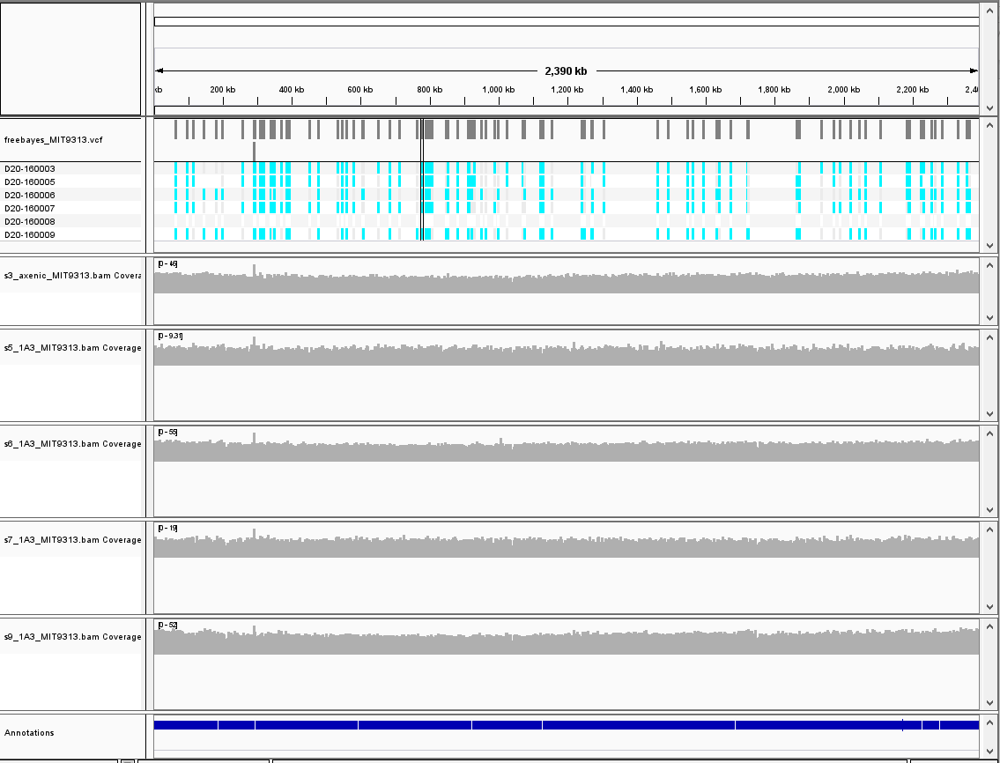

Slide 11
All MIT0604 samples
Axenic MIT0604 samples
Name | Total Alignment Length | Number Of Contigs | Mean Bit Score
Alteromonas macleodii | 7,460,367 | 2,066 | 6,248
Alteromonas macleodii ATCC 27126 | 3,022,314 | 2,002 | 2,091
Alteromonas macleodii str. 'English Channel 673' | 2,611,950 | 1,954 | 2,056
Alteromonas mediterranea | 2,469,162 | 922 | 2,750
Alteromonas macleodii str. 'Balearic Sea AD45' | 2,458,683 | 1,900 | 2,067
Alteromonas macleodii str. 'Black Sea 11' | 1,860,123 | 1,514 | 1,677
Maricaulis maris MCS10 | 955,015 | 14 | 584
Alteromonas sp. BL110 | 918,890 | 852 | 946
Methylophaga nitratireducenticrescens | 743,174 | 38 | 488
Alteromonas mediterranea UM7 | 573,632 | 703 | 769
Alteromonas sp. Mex14 | 555,758 | 514 | 551
Alteromonas mediterranea DE1 | 534,202 | 662 | 728
Alteromonas mediterranea UM4b | 519,872 | 666 | 739
Alteromonas mediterranea U8 | 310,676 | 333 | 356
Alteromonas mediterranea U7 | 281,618 | 303 | 352
Alteromonas mediterranea 615 | 250,452 | 242 | 258
Glycocaulis alkaliphilus | 233,940 | 6 | 210
Alteromonas mediterranea U4 | 214,386 | 259 | 281
Methylophaga frappieri | 214,225 | 24 | 136
Alteromonas mediterranea MED64 | 206,153 | 244 | 265
Name | Total Alignment Length | Number Of Contigs | Mean Bit Score
Methylophaga nitratireducenticrescens | 564,285 | 162 | 492
Methylophaga frappieri | 178,618 | 105 | 152
Maricaulis maris MCS10 | 40,090 | 82 | 86
Pseudomonas aeruginosa | 35,059 | 10 | 43
Serratia marcescens | 32,122 | 12 | 49
Pseudomonas putida | 26,851 | 29 | 38
Pseudomonas fluorescens | 26,231 | 28 | 43
Morganella morganii | 25,813 | 8 | 38
Pseudomonas chlororaphis subsp. piscium | 23,855 | 3 | 25
Pseudomonas stutzeri | 23,067 | 21 | 33
Pseudomonas mendocina | 22,998 | 15 | 24
Escherichia coli | 20,764 | 5 | 26
Marinobacter sp. CP1 | 18,264 | 11 | 14
Shewanella algae | 17,022 | 7 | 25
Acinetobacter indicus | 16,750 | 4 | 18
Pantoea agglomerans | 14,930 | 6 | 22
Enterobacter kobei | 14,414 | 3 | 13
Phaeobacter gallaeciensis | 14,287 | 2 | 13
Aeromonas caviae | 14,285 | 2 | 7
Ralstonia solanacearum | 13,549 | 6 | 27
Unmapped sequences – BLAST results

Slide 12
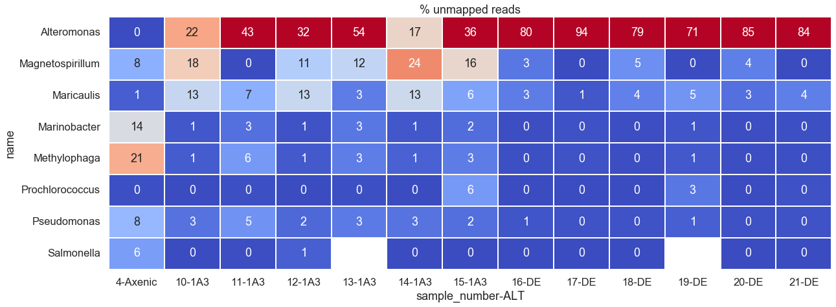
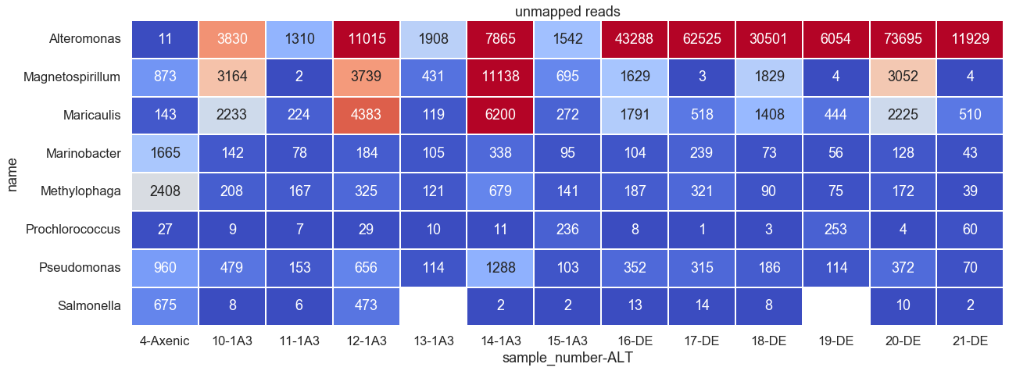
Kraken results on unmapped sequences

Slide 13
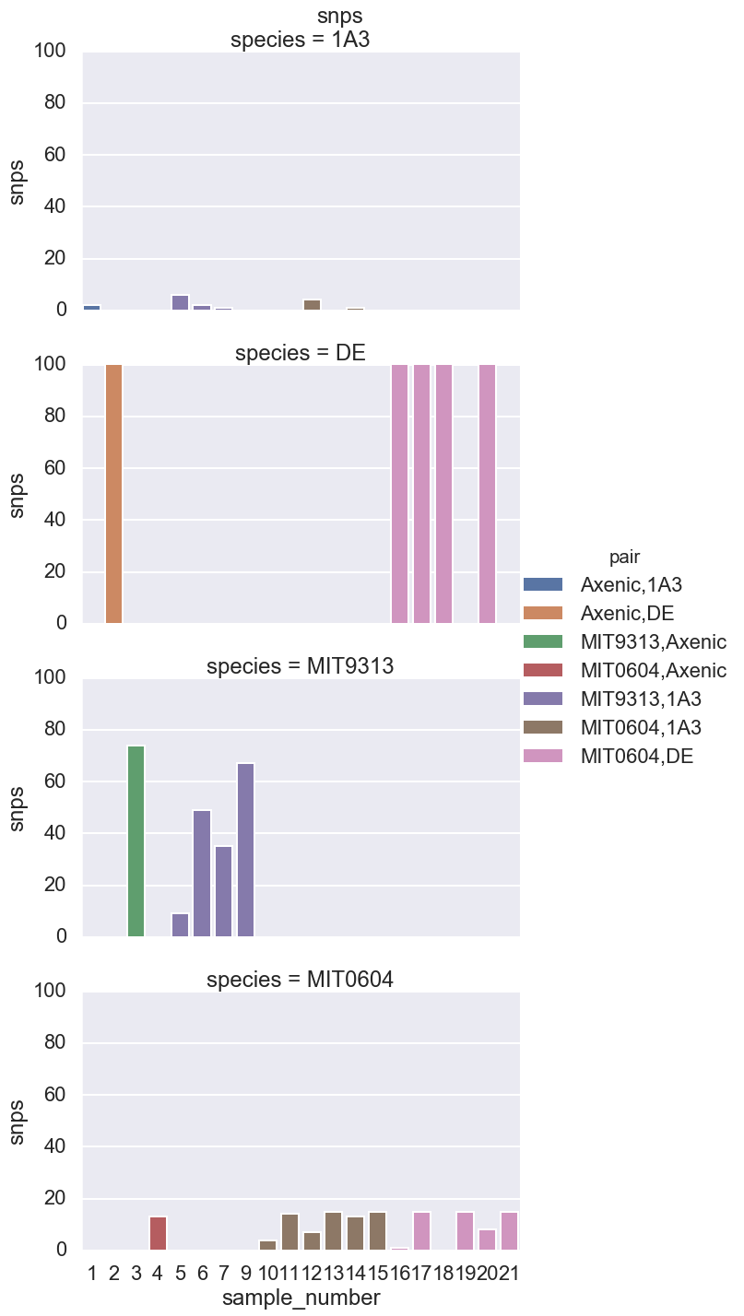
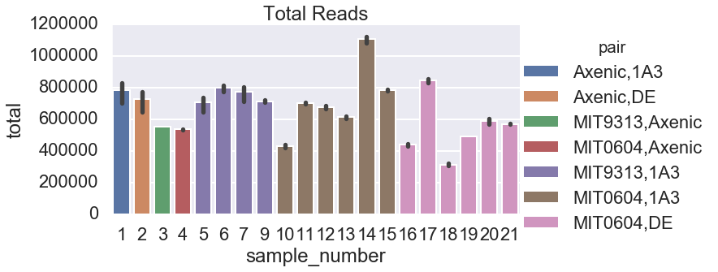
# | sample | PRO | ALT | exp | days | ng/ul | final volume
1 | Axenic | Axenic | 1A3 | 0 | 0 | 30 | 100
2 | Axenic | Axenic | DE | 0 | 0 | 10 | 100
3 | Axenic | MIT9313 | Axenic | 0 | 0 | 0.6 | 100
4 | Axenic | MIT0604 | Axenic | 0 | 0 | 6 | 100
5 | 2A | MIT9313 | 1A3 | 0 | 100 | 0.7 | 100
6 | 2A | MIT9313 | 1A3 | 6 | 440 | 1.2 | 100
7 | 2C | MIT9313 | 1A3 | 2 | 100 | 1.5 | 100
8 | empty | empty | empty | empty | empty | empty | empty
9 | 2C | MIT9313 | 1A3 | 6 | 440 | 8 | 100
10 | 5A | MIT0604 | 1A3 | 2 | 100 | 4.28 | 100
11 | 5A | MIT0604 | 1A3 | 6 | 440 | 16 | 100
12 | 5B | MIT0604 | 1A3 | 2 | 100 | 3.75 | 100
13 | 5B | MIT0604 | 1A3 | 6 | 440 | 7.3 | 100
14 | 5C | MIT0604 | 1A3 | 2 | 100 | 9.3 | 100
15 | 5C | MIT0604 | 1A3 | 6 | 440 | 19.3 | 100
16 | 10A | MIT0604 | DE | 2 | 100 | 5.85 | 100
17 | 10A | MIT0604 | DE | 6 | 440 | 14 | 100
18 | 10B | MIT0604 | DE | 2 | 100 | 1.6 | 100
19 | 10B | MIT0604 | DE | 6 | 440 | 6.25 | 100
20 | 10C | MIT0604 | DE | 2 | 100 | 5.34 | 100
21 | 10C | MIT0604 | DE | 6 | 440 | 18 | 100

Slide 14
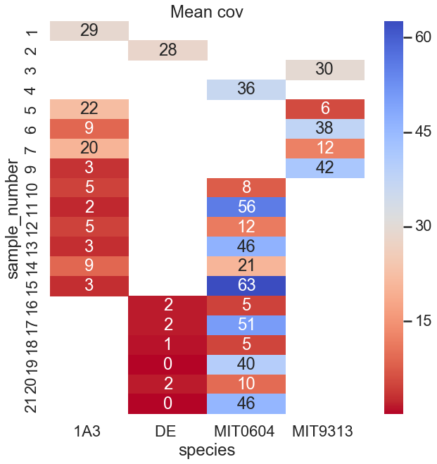
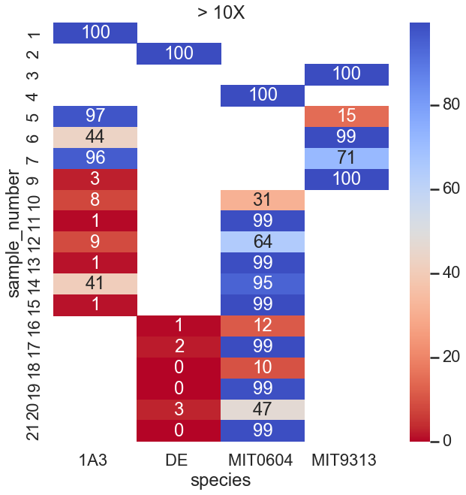

Slide 15
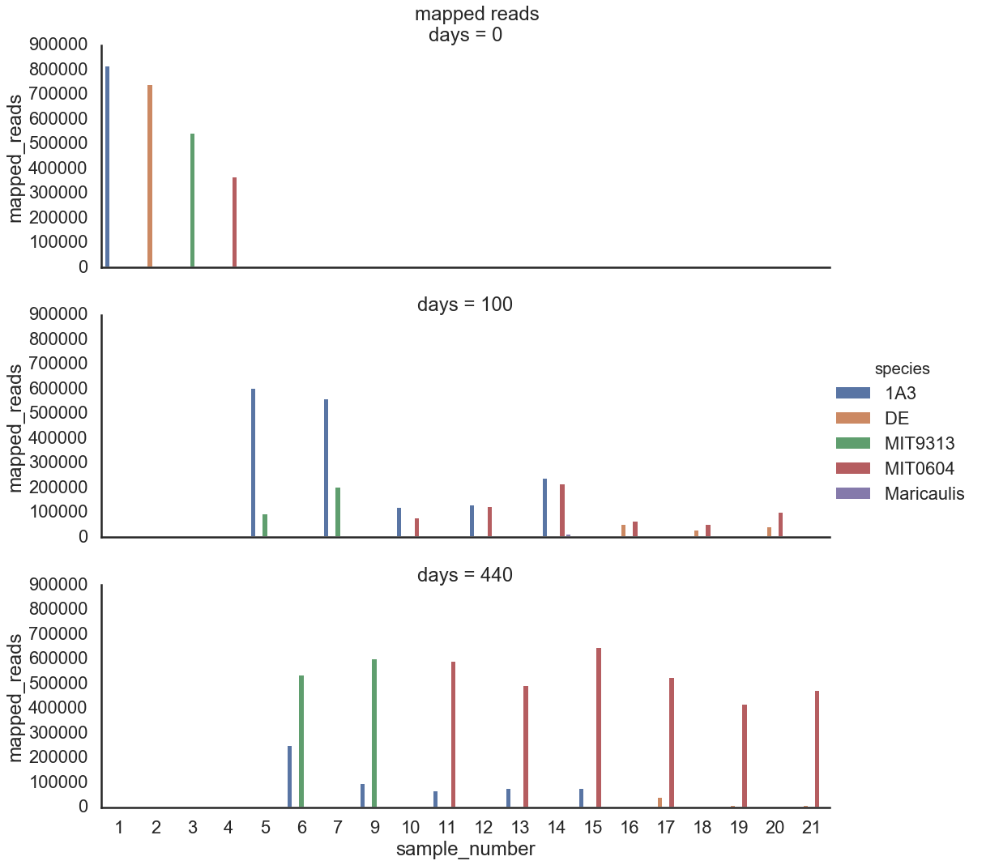

Slide 16
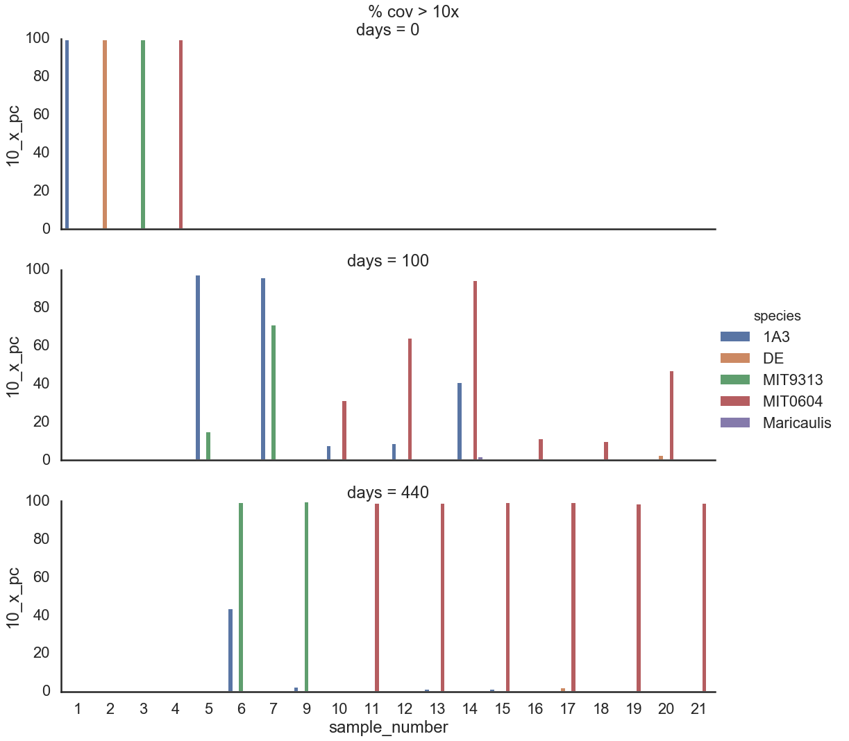

Slide 17
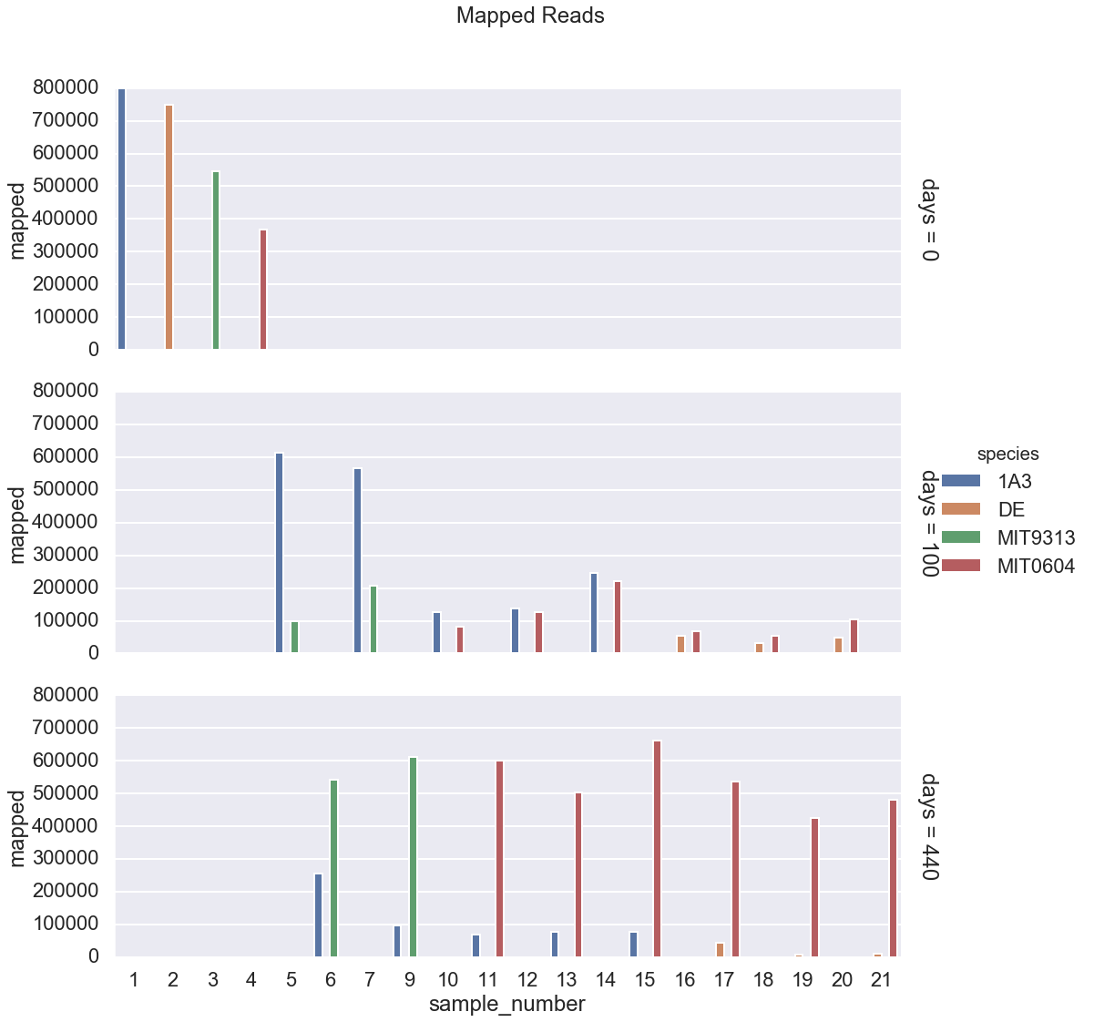
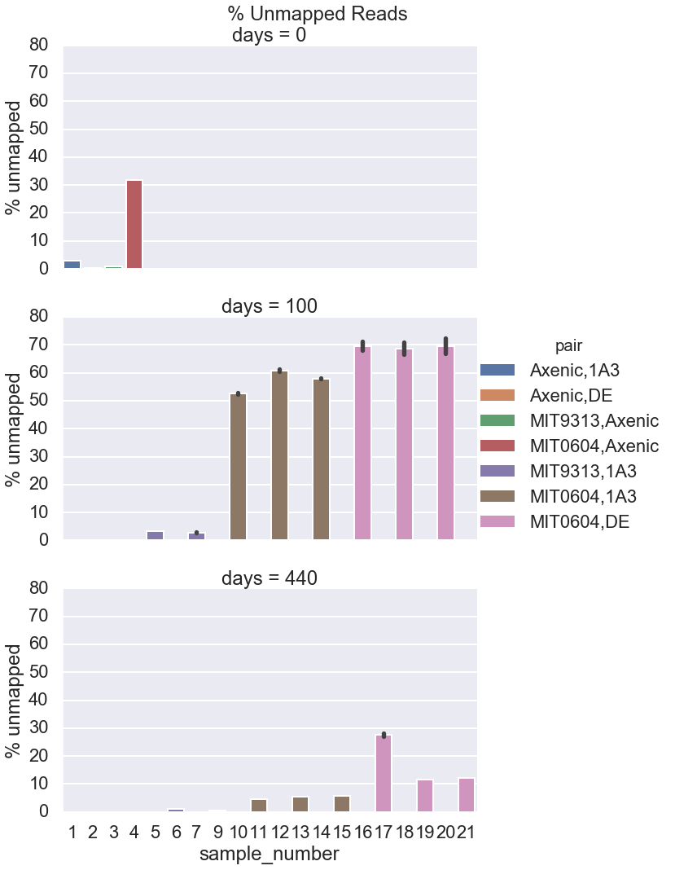

Slide 19
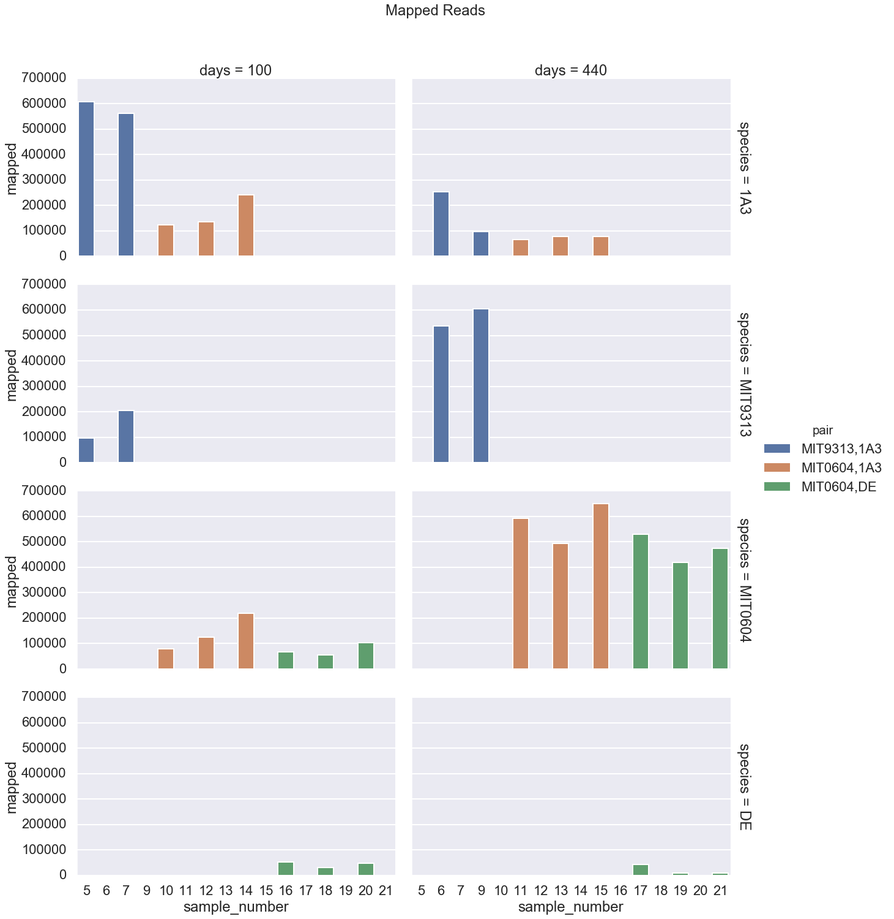
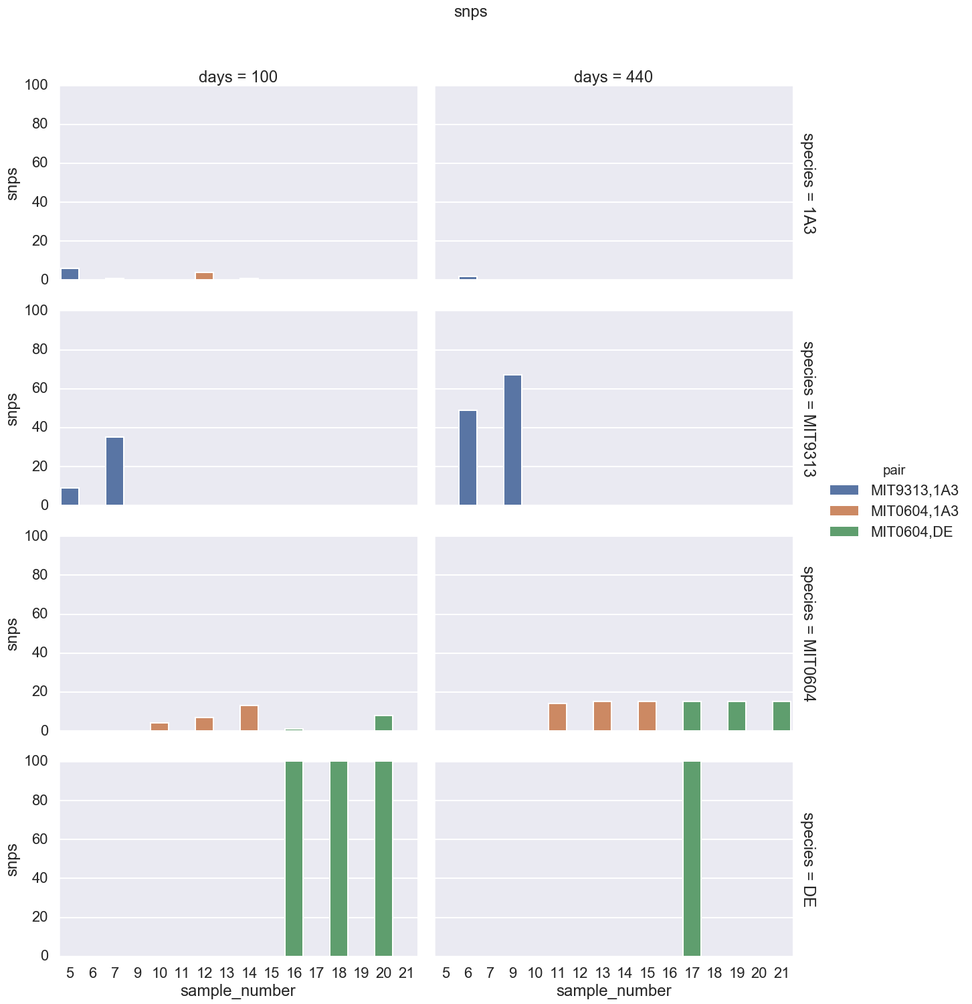

Slide 20
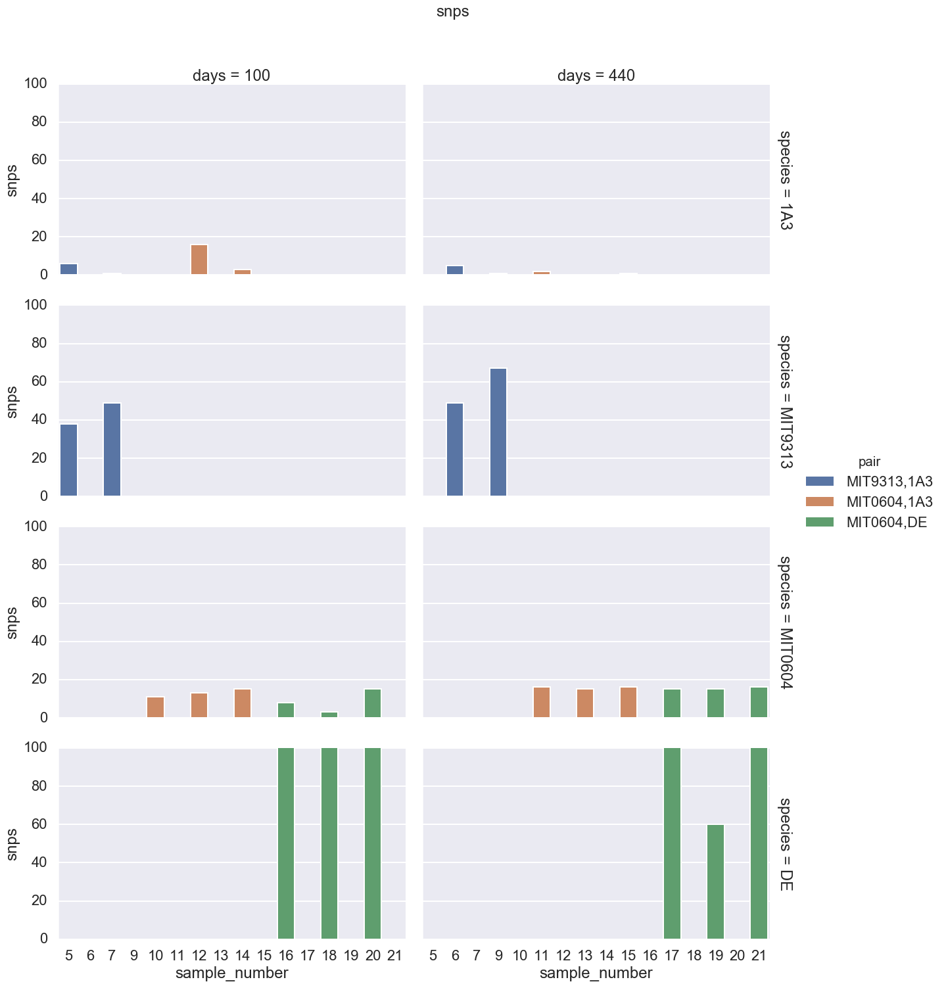
The variant calling is done by Freebayes. The key parameters under user control are:
--mincov - the minimum number of reads covering a site to be considered (default=10)
--minfrac - the minimum proportion of those reads which must differ from the reference
--minqual - the minimum VCF variant call "quality" (default=100)
Min coverage = 10
Min coverage = 5

